Slide 1
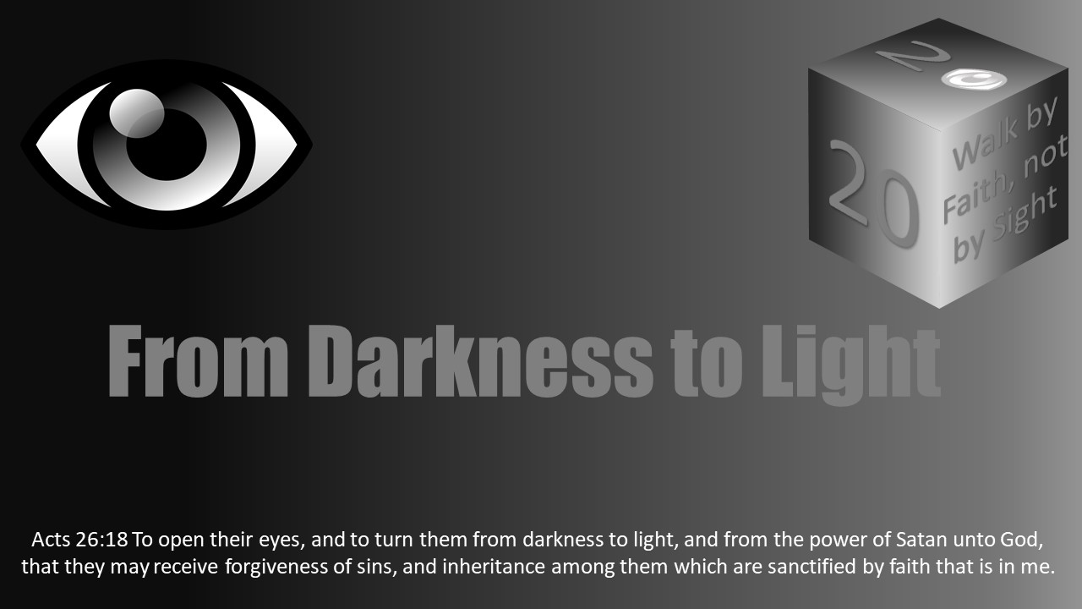


Slide 2
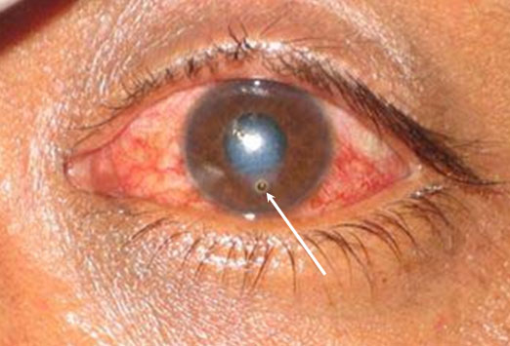
Darkness Lesson 16 The Corneal Foreign Body, Sin, and Hypocrisy

Slide 3
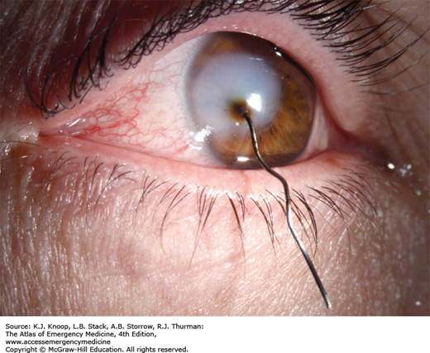
Introduction
If you had the nerve to look at these pictures you were probably feeling their pain.
The cornea is the clear front surface of the eye and it has more pain receptors per square millimeter than any other part of the body!
Even the smallest of “foreign bodies” or “specks” feels like a beam or boulder.
The most common material that gets lodged in the cornea is metal, but anything from wood to insect parts can find its way in there.

Slide 4
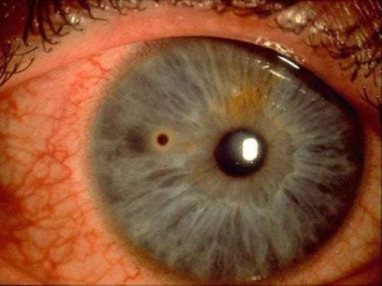
Introduction
What does this have to do with my soul?
Most Bible students will go directly to the Matthew 7:1-5. One should remove the beam from own eye before helping another, and whatever you do, DO NOT JUDGE!

Slide 5
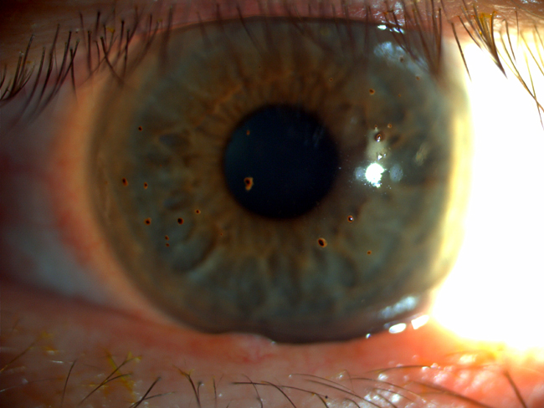
The Importance of Eyes
Why were we created this way with such sensitivity on such a tiny body part? How does the brain process visual information? Ninety percent of information transmitted to the brain is visual. Seventy percent of your sensory receptors are in your eyes. Up to fifty percent of your brain is active in visual processing. Seventy-five percent of learning occurs through vision.
No wonder Jesus tells us in Matthew 6:22 (NASB) "The eye is the lamp of the body; so then if your eye is clear, your whole body will be full of light.”

Slide 6
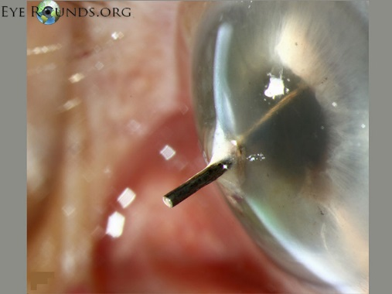
How Did The Foreign Body Get In The Eye?
We are all led to believe that to protect our eye we need to wear eye protection, and we should. However, even with the most protective eyewear, mistakes do occur.
As an eye doctor for eighteen years, I have treated corneal foreign bodies in retired individuals who were wearing multiple layers of safety equipment including safety glasses and a full face shield.
Another example is my 4 year old patient, who does not wear glasses, who came to my office with a piece of rust embedded in his cornea. Neither he nor his parents knew how the rust got in his eye.
Relating the physical to the spiritual, just as anyone at any age can get a speck or a beam in their eye, we observe that any individual at any spiritual level sins.
Even the seasoned Christian who takes precautions will sin, as does the new convert (spiritually immature) who is zealous for the Lord and yet will leave himself or herself vulnerable to sin. Consider the corneal foreign body as a metaphor for sin.

Slide 7
What Were You Doing When You Were Injured?
When a patient comes in my office, this is the question that is asked – “what were you doing when your injury occurred?”
Metal corneal foreign bodies/injuries typically occur when grinding or welding. Organic foreign bodies such as wood, plant material, or insects typically occur with outdoor activities – chain-sawing, weed eating, hiking, and biking are common examples.
1 Peter 5:8 warns Christians, “Be of sober spirit, be on the alert. Your adversary, the devil, prowls around like a roaring lion, seeking someone to devour. Sometimes it is just habit or sometimes we have made an unnecessary allowance for the flesh.
Everyone has a specific weakness or a cross they must bear. We are called to be holy.
We are to be in the world but not of the world. (John 15:19; John 17:14-16).

Slide 8
What Are Your Weaknesses?
Do you put yourself in situations where sinning is more convenient?
In what ways do you protect yourself from sin?
I am not going to grind metal without eye protection.
Too often we place ourselves in places of weakness without the proper precaution.

Slide 9

What Are Your Weaknesses? (Children’s song)
O be careful little eyes what you see
O be careful little eyes what you see
For the Father up above
Is looking down in love
So, be careful little eyes what you see
O be careful little ears what you hear
O be careful little ears what you hear
For the Father up above
Is looking down in love
So, be careful little ears what you hear
O be careful little tongue what you say
O be careful little tongue what you say
For the Father up above
is looking down in love
So, be careful little tongue what you say

Slide 10
Were You Simply at the Wrong Place at the Wrong Time?
Many have entered a space where they did not know of a danger and a foreign body got into their eye.
Spiritually, most of us have been there. We were trying to be good, but found ourselves in the wrong place at the wrong time.
We were trying to avoid the person, places and things that draw us toward sin, but it happened. T
he devil comes as an angel of light. “No wonder, for even Satan disguises himself as an angel of light. Therefore it is not surprising if his servants also disguise themselves as servants of righteousness, whose end will be according to their deeds.” (2 Corinthians 11:14-15 NASB).

Slide 11
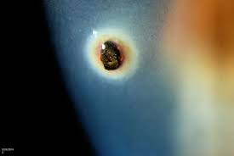
Were You Simply at the Wrong Place at the Wrong Time?
As Christians we have the opportunity to be able to discern good and evil.
“But solid food is for the mature, who because of practice have their senses trained to discern good and evil” (Hebrews 5:14). T
his requires study and use of the God’s word and diligence in application.
Christians understand the scriptures as the sword in our armor. To be a good sword person requires time and practice.

Slide 12
Were You Simply at the Wrong Place at the Wrong Time?
It is a good thing to want to help someone in need.
The good Samaritan is a wonderful example of who we strive to be like.
We must also be very careful on where we go and what we do in the name of “helping someone.” We all need to have boundaries.
As the scriptures advise, children of light must be gentle as doves but wise as serpents (Matt 10:16).
Is it appropriate to have a “bar ministry”? After all, to reach the lost we must go where the sinners are. What if you have alcoholic tendencies? Is it wrong then? Can you think of other examples?

Slide 13
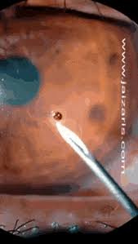
Do You Treat Sin In Your Life Like A Corneal Foreign Body?
Do we treat sin the same way as a corneal foreign body? Anyone can take time out of their lives to seek an eye doctor to have a large metal corneal foreign body removed, but you might be surprised how many individuals will leave a small miniscule piece in their eye for weeks, walking around in pain until it becomes unbearable.
Once removed, you have to give the eye time to heal.
Although the eye heals faster than any body part, it still needs time.
If the object penetrated deep enough it will scar. Depending on where the scar is located on the eye will determine how much it will affect your vision for the rest of your life.

Slide 14
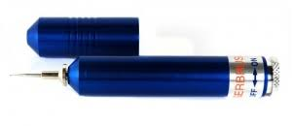
Do You Treat Sin In Your Life Like A Corneal Foreign Body?
What sin hit you like a piece of metal in the eye?
What sin in your life did you leave to fester and worsen?
Were you able to help a fellow Christian with their sin because you had previously dealt with something similar?
Steel hardens steel – Who is your steel? Do you have someone to help you be accountable with a pattern of sin?
If you were approached for confession and help, are approachable? Are you of the "GOTCHA" mind set or of the kind and helping mind set?
Do you practice confession to God with other Christians as instructed in God’s word ? Too often we think we can handle sin and not get burned. Too often we fail to take the steps need to eliminate the sin. When necessary, I often have to use a spud, needle, or small drill (Alger brush) to take a foreign body out an eye. Those processes are not pleasant but necessary. Likewise, removal of sin from our lives is often not easy.

Slide 15
Do You Treat Sin In Your Life Like A Corneal Foreign Body?
How sensitive is your soul?
Is your soul’s sensitivity heightened to a point where even the smallest offense will drive you to rectify the situation immediately?
Or do you live with scars that are in the periphery of your life that are soon forgotten because it did not really affect your conscience, only to cause you to incur injury after injury until one day it blinds you into hardening your heart to God.
Psalms 139: 23-24: “Search me, O God, and know my heart! Try me and know my thoughts! And see if there be any grievous way in me, and lead me in the way everlasting!”

Slide 16
Do You Treat Sin In Your Life Like A Corneal Foreign Body?
“Lord Make Calvary Real to Me.”
Verse 1: Show me the cross of Calvary, open my eyes to see thy dying form in agony, Lord make it real to me.
Verse 2: Show me the cross of Calvary, open my ears to thy plea; “Father, forgive them!” can it be? Lord make it real to me.
Verse 3: Low at the cross of Calvary, bowed is my heart as I see grace can save eternally, Lord make it real to me.
Chorus: Lord, make Calvary real to me! Jesus, dying in agony, thy great sacrifice let me see; Lord, make Calvary real to me!

Slide 17
Do You Treat Sin In Your Life Like A Corneal Foreign Body?
Like the very sensitive cornea, the more we understand what Christ has done for us, the more we see His great sacrifice, the more sensitive our souls become and the more quickly we will seek forgiveness and elimination of the sin in our lives.

Slide 18
Hypocrisy and The Corneal Foreign Body
Matthew 7:1-6.
¹Do not judge so that you will not be judged. 2 "For in the way you judge, you will be judged; and by your standard of measure, it will be measured to you. 3 "Why do you look at the speck that is in your brother's eye, but do not notice the log that is in your own eye? 4 "Or how can you say to your brother, 'Let me take the speck out of your eye,' and behold, the log is in your own eye? 5 "You hypocrite, first take the log out of your own eye, and then you will see clearly to take the speck out of your brother's eye. 6 "Do not give what is holy to dogs, and do not throw your pearls before swine, or they will trample them under their feet, and turn and tear you to pieces.

Slide 19
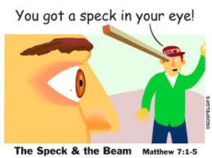
Hypocrisy and The Corneal Foreign Body
This is a popular text because people do not want any one to challenge their behavior.
People are fond of saying they are leaving Jesus and the church because the church has a bunch of hypocrites.
There are some huge logic failures in such comments.
Moreover, those people are allowing a hypocrite to get between them and God. Hypocrites often cause damage to others (Proverbs 11:9).

Slide 20

The Mask of Hypocrisy
Peter, an apostle and leader among the disciples got caught up in wrong doing such that Paul had to call him out. (See Galatians 2:11ff).
The NASB translation uses the word hypocrisy to describe Peter’s behavior. He was behaving in a way that contradicted what he said he was.
Can we identify Peter as a hypocrite? Tough as it is, it is in the text.

Slide 21
The Mask of Hypocrisy
Hypocrisy is a common charge people enjoy throwing at Christians, especially if they have been hurt by individuals in the church.
In surveys of millennials, one of the most common reasons noted for leaving the church is “hypocrisy.”
Contemplating the meaning of hypocrisy requires us to look at the scriptures closer.
Jesus uses this term.
As one considers the definition of hypocrisy, the word “actor” or someone who is pretending to be something they are not, to put on a show, fake, and fraud are common understandings

Slide 22
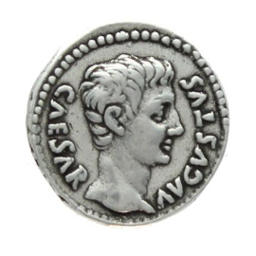
The Mask of Hypocrisy – Matt 22:15-21
Then the Pharisees went and plotted together how they might trap Him in what He said. And they sent their disciples to Him, along with the Herodians, saying, “Teacher, we know that You are truthful and teach the way of God in truth, and defer to no one; for You are not partial to any. “Tell us then, what do You think? Is it lawful to give a poll-tax to Caesar, or not?” But Jesus perceived their malice, and said, "Why are you testing Me, you hypocrites? ‘Show Me the coin used for the poll-tax.’ And they brought Him a denarius. And He said to them, “Whose likeness and inscription is this?" They said to Him, "Caesar's." Then He said to them, "Then render to Caesar the things that are Caesar's; and to God the things that are God's."

Slide 23
The Mask of Hypocrisy – Matt 6:1-6
"Beware of practicing your righteousness before men to be noticed by them; otherwise you have no reward with your Father who is in heaven. "So when you give to the poor, do not sound a trumpet before you, as the hypocrites do in the synagogues and in the streets, so that they may be honored by men. Truly I say to you, they have their reward in full. "But when you give to the poor, do not let your left hand know what your right hand is doing, so that your giving will be in secret; and ⁴your Father who sees what is done in secret will reward you. "When you pray, you are not to be like the hypocrites; for they love to stand and pray in the synagogues and on the street corners so that they may be seen by men. Truly I say to you, they have their reward in full. "But you, when you pray, go into your inner room, close your door and pray to your Father who is in secret, and ⁹your Father who sees what is done in secret will reward you.
Again, we see Jesus condemn those who make religion a show, façade, a mask when their heart is not committed

Slide 24
Further Defining Hypocrisy: The Heart
Matthew 15:7-9 also helps us define hypocrite:
"You hypocrites, rightly did Isaiah prophesy of you: 'THIS PEOPLE HONORS ME WITH THEIR LIPS, BUT THEIR HEART IS FAR AWAY FROM ME. 'BUT IN VAIN DO THEY WORSHIP ME, TEACHING AS ⁷DOCTRINES THE PRECEPTS OF MEN.'
Their lips honor God, but their heart is not there.
Hypocrisy is not a moral failure or sin as a single event because even the most mature Christian will sin.
However, hypocrisy is a mask or show of faith when a person’s heart is not with God.

Slide 25
Further Defining Hypocrisy: The Heart
Hypocrites are not people who just mess up and sin. We all have moments of spiritual failures.
Christians are seeking to be godly, yet we may fail. We all are growing.
When we were baptized into Christ, bad habits and addictions did not magically disappear. Putting away those behaviors and growth takes time.
The church is made up of the broken and sinful who have repented with a contrite heart and seek God.
The pretending role is hypocrisy. To call something hypocrisy requires knowing the inward heart instead of just an outward appearance. The hypocrite pretends to create a mirage.

Slide 26
Further Defining Hypocrisy: The Heart
However, Jesus always knows the heart.
“But Jesus, on His part, was not entrusting Himself to them, for He knew all men, and because He did not need anyone to testify concerning man, for He Himself knew what was in man” (John 2:24-25).
When Ananias and Sapphira lied about the price of the property they sold, it was not fooling God (Acts 5:1-10).
Hypocrites often forget God, and thus lose their hope (Job 8:13-15).

Slide 27
Be Careful of Judgments
Since we cannot know the heart, Christians must be careful of their judgments.
We must be very careful of thinking hypocrisy because trying to live godly and wrong behavior does not mean hypocrisy.
Hypocrisy is a corrupt heart with a mask. However, sinning or having a spiritual flaw is common to our lives. We are taught to put sin away and live holy.
The point is that hypocrisy is not the only explanation for bad or immoral behavior.
Good people, including Christians, do the wrong thing sometimes. Paul discusses his own internal struggle in Romans 7:14-15. (Some see this text differently).

Slide 28
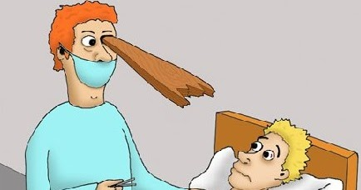
Be Careful of Judgments
Sometimes, good hearts do the wrong
thing.
God’s word teaches us to guard our hearts (Proverbs 4:23).
Christians are in a process of growth and transformation (Romans 12:1-2, Col 1:9-10).
Growth takes time.
Have you ever slipped back into an old sin? Ever slipped from a friendly visit to gossiping?
Ever lost your temper and become angry?

Slide 29
Be Careful of Judgments
Judging others really most often leads to hypocrisy as we measure out a standard for others we most often do not want applied to us.
This is the real speck and beam of Matthew 7.
When we measure and do not know another's heart, this is hypocrisy.
Instead, we should take heed of our own footing while seeking to help others enslaved by sin.

Slide 30
Be Careful of Judgments
Satan uses both sides of judging and hypocrisy to ensnare as many as he can. How can we guard against this?
First, we must be careful how we conduct our lives, including a willingness to practice confession as taught in God's word.
Second, we must start with the right attitude in all our teaching and works in service to God. It must be an attitude of care, compassion, love, and kindness, especially to those who are caught up in sin.
Our enemy is not the false teachers or person living an immoral life, but our enemy is Satan. Those other people are in the Devil’s clutches.
Too often we have people on Facebook or in person defending the truth without kindness. Instead, they come across with truth in a tone of hate. This should not be.

Slide 31
Be Careful of Judgments
2 Timothy 2:23-26 helps us find the right attitude:
But refuse foolish and ignorant speculations, knowing that they produce quarrels. The Lord's bond-servant must not be quarrelsome, but be kind to all, able to teach, patient when wronged, with gentleness correcting those who are in opposition, if perhaps God may grant them repentance leading to the knowledge of the truth, and they may come to their senses and escape from the snare of the devil, having been held captive by him to do his will.

Slide 32
Corneal Foreign Body and Hypocrisy
We must be careful that we are not falling to hypocrisy by putting on a show of faith.
We must be careful not to fall into the same trap by judging others knowing that we do not know their heart.
We must teach with the right attitude of kindness.
In the end, God’s eyes see it all.
Our façade might fool many, but not God.

Slide 33
Corneal Foreign Body and Hypocrisy
Therefore let us be diligent to enter that rest, so that no one will fall, through following the same example of disobedience. For the word of God is living and active and sharper than any two-edged sword, and piercing as far as the division of soul and spirit, of both joints and marrow, and able to judge the thoughts and intentions of the heart. And there is no creature hidden from His sight, but all things are open and laid bare to the eyes of Him with whom we have to do. (Hebrews 4:11-13 NASB).

